Slide 1
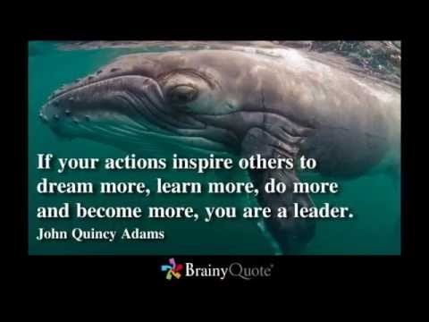
Notes:
John Quincy Adams , son of John(1st vice and 2nd pres and Abigal, July 11, 1767 – February 23, 1848) was the sixth President of the United States from 1825 to 1829. He also served as a diplomat, a Senator and member of the House of Representatives
You will see a number of these types of slides during this presentation. Power point presentations can easily become read a longs, and a subject like this should not be cornered into facts and figures. Leadership is a dynamic important subject that is heavily studied by sociologists and psychologist. The idea behind this talk is if learn more about leadership and recognize its potential and within ourselves, than we can positively impact our professions, our careers and our patients.
Good goals

Slide 2
Leadership and the RCP Having a Professional Voice
Jhaymie L Cappiello MS RRT-ACCS RCP
Notes:
Intro yourself

Slide 3
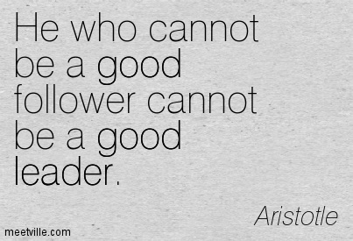
Notes:
Is this true? Don’t answer out loud, I will ask many rhetorical questions here. But seriously, do you believe that truths can be simplified into a statement without any qualifiers?
Do you think Barack Obama would be a good follower in a group led by Fidel Castro? Or the like wise as well...

Slide 4
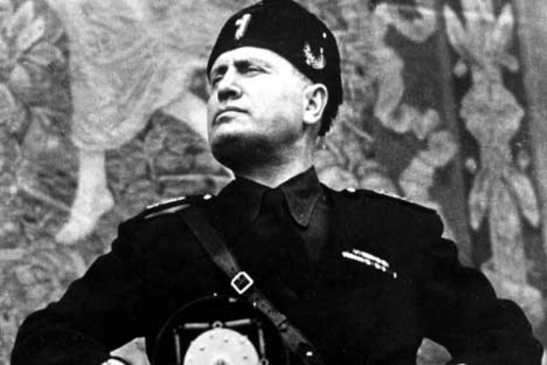
Notes:
Is Benito Mussolini an example of a good follower and a good leader? Ok, lets change that to strong instead of good, or even accomplished...maybe if we said an accomplished follower can be an accomplished leader....that might work...I don’t know...leadership requires many parts to fit in the right places. It is not very simple.

Slide 5
Objectives
Define and identify Leadership
Describe Leadership Theories and Styles
Discuss the application and benefits of leadership skills
Discuss leadership as a source of growth
Notes:
To satisfy the CE requirements...
by then end of this session you will be able to
Define and identify Leadership
Describe some Leadership Theory and Styles
Discuss the practical application and benefits of developing leadership skills
Discuss leadership as a source of community growth

Slide 6
“There are almost as many different definitions of
leadership as there are people who have tried to
define it” Stogdill
Notes:
Ralph Stogdill was a Professor Emeritus of Management Science and Psychology at Ohio State University and was internationally known for his research and publications on leadership and organizations. He was a Fellow of both the American Psychological Association and the Academy of Management. Stogdill became a leader in leadership research with the publication of his first article "Personal Factors Associated with Leadership: A Survey of the Literature" in 1948. In 1974 he authored the fundamental Handbook of Leadership: A Survey of Theory and Research.
To define leadership like someone who has followers or someone who gets people to accomplish tasks is underestimating the various factors that come together to create leadership. Note, I say leadership and not leaders, leaders is an adjectives, describing a person, leadership is a noun inferring guiders.
Leadership can truly only be found in a group that has some direction, up, down, forward, backward, even stagnant groups have leadership. Lets’ agree that Leadership is the guiding philosophy the common goals, of a group whether it be from a singular person or a group. Does that work?

Slide 7
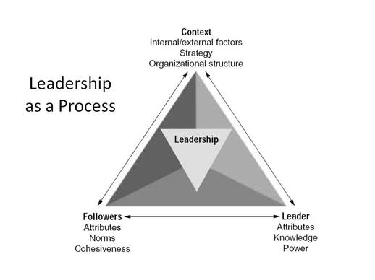
Leadership
Involves Common Goals
Involves Influence
Is a Process
Notes:
Lets take it one step further
To have leadership, we need a group and a direction or goals, which we already agreed on. But there is one more thing. As exampled in our own society with the political office elections, leadership ....its goals and movement, are greatly impacted by other factors...desires of the group and the individuals that act as leaders. It truly is multifactorial and therefore becomes a process.
A process that is ever evolving as is dictated by the needs of the group and its desire to exist.
Leadership now is no longer a stagnant word that can be defined but must be viewed in a context of group dynamics.
A dynamic force

Slide 8
Notes:
We cannot simply say that leadership is the power or ability to lead other people. That sounds more like a job description.....
We all have our unique ideas about leadership, but they are fundamentally the same....
Some people think leadership means guiding others to complete a particular task, while others believe it means motivating the members of your team to be their best selves.
In spite of our varied definitions, the general sentiments remain the same:
Leadership enables the achievement of goals by the group and inspires the group along the way

Slide 9
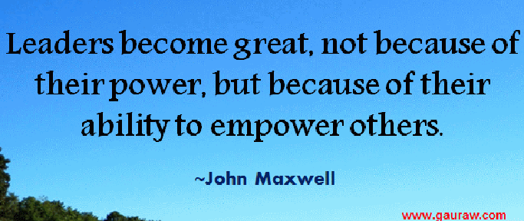
Notes:
is an American author, speaker, and pastor who has written many books, primarily focusing on leadership. Titles include The 21 Irrefutable Laws of Leadership and The 21 Indispensable Qualities of a Leader. His books have sold millions of copies, with some on the New York Times Best Seller List.
Maxwell is a leadership expert, speaker, and author.^{[5]} He is the founder of INJOY, Maximum Impact, The John Maxwell Team, ISS and EQUIP. EQUIP is an international leadership development organization working to help leaders,^{[3]} involved with leaders from more than 80 nations
Do me a favor, whenever you see the word “Leader”, change it to leadership.
John Maxwell here states in other words....”together we’re better”
Sounds like a trickle up philosophy or maybe the whole is greater than the sum of its parts “Aristotle”

Slide 10
Leadership Theories
Great Man
Trait
Behavioral
Contingency
Transactional/Exchange
Transformational
Notes:
Leadership study has evolved over the years, here are six of the more popular theories
Great Man
The Great Man theory evolved around the mid 19th century. Even though no one was able to identify with any scientific certainty, which human characteristic or combination of, were responsible for identifying great leaders. Everyone recognized that just as the name suggests; only a man could have the characteristic (s) of a great leader.
The Great Man theory assumes that the traits of leadership are intrinsic. That simply means that great leaders are born
Trait The trait leadership theory believes that people are either born or are made with certain qualities that will make them excel in leadership roles.
Behavioral focuses on the behaviors of the leaders as opposed to their mental, physical or social characteristics. Divided leaders in two categories. Those that were concerned with the tasks and those concerned with the people
Contingency argues that there is no single way of leading and that every leadership style should be based on certain situations, which signifies that there are certain people who perform at the maximum level in certain places; but at minimal performance when taken out of their element
Transactional/Exchange Characterized by a transaction made between the leader and the followers. In fact, the theory values a positive and mutually beneficial relationship.
Transformational this process is by which a person interacts with others and is able to create a solid relationship that results in a high percentage of trust, that will later result in an increase of motivation, both intrinsic and extrinsic, in both leaders and followers.
The essence of transformational theories is that leaders transform their followers through their inspirational nature and charismatic personalities. Rules and regulations are flexible, guided by group norms. These attributes provide a sense of belonging for the followers as they can easily identify with the leader and its purpose.
Yes, these theories evolved quite consistent with how our attitudes towards each other have grown as well. Our society was quite different in the 19th century

Slide 11
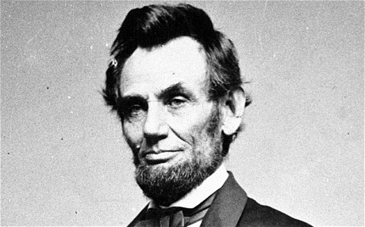
Notes:
Our society was quite different in the 19th century
Here is a great man, and with great traits too

Slide 12
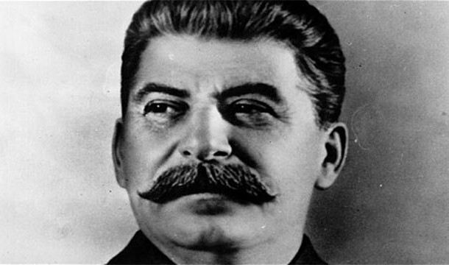
Notes:
Stalin was one of the seven members of the first Politburo, founded in 1917 in order to manage the Bolshevik Revolution, alongside Lenin, Zinoviev, Kamenev, Trotsky, Sokolnikov, and Bubnov.^{[3]} Among the Bolshevik revolutionaries who took part in the Russian Revolution of 1917, Stalin was appointed General Secretary of the party's Central Committee in 1922. He managed to consolidate power following the 1924 death of Vladimir Lenin by suppressing Lenin's criticisms (in the postscript of his testament) and expanding the functions of his role, all the while eliminating any opposition. He remained General Secretary until the post was abolished in 1952, concurrently serving as the Premier of the Soviet Union from 1941 onward

Slide 13
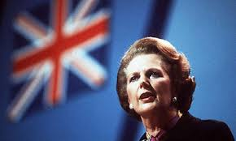
Notes:
Margaret Hilda Thatcher, Baroness Thatcher, LG, OM, PC, FRS, FRIC (née Roberts; 13 October 1925 – 8 April 2013) was a British politician and stateswoman who was the Prime Minister of the United Kingdom from 1979 to 1990 and the Leader of the Conservative Party from 1975 to 1990. She was the longest-serving British prime minister of the 20th century and the first woman to have held the office. A Soviet journalist dubbed her the "Iron Lady", a nickname that became associated with her uncompromising politics and leadership style. As Prime Minister, she implemented policies that have come to be known as Thatcherism.

Slide 14
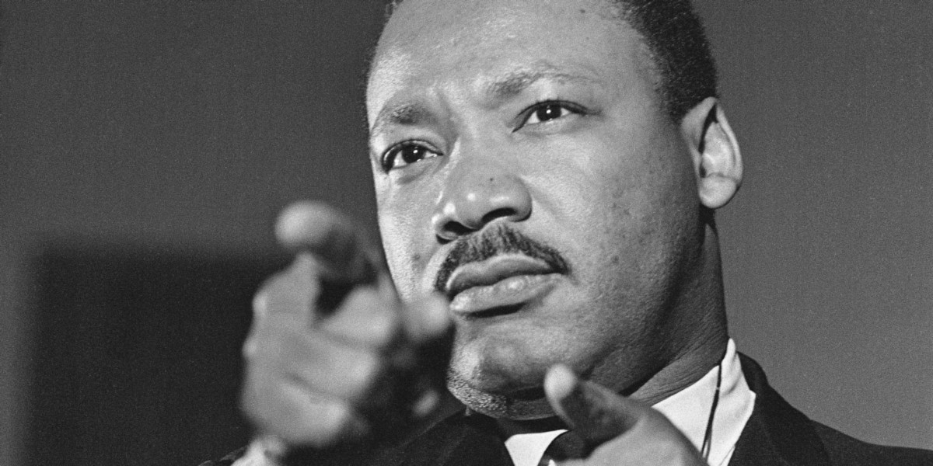
Notes:
Whatever the theory you wish to ascribe to, what we really want are results, what we are concerned with is a goal is accomplished.

Slide 15
Leadership Styles
Participative
Authoritarian
Laissez-Faire
Transformational
Servant
Notes:
LEADERSHIP STYLE Is the pattern of behaviors you can use when you are trying to influence the behavior of others as perceived by them.
Participative
Also known as democratic leadership, the participative leadership style focuses on culling opinions from all employees , majority rules.
The participative leadership style is particularly useful if the leader wishes to encourage participation and agreement.
2. Authoritarian
leaders inform followers of a common goal and detail responsibilities. There is a clear division between follower and leader .The authoritarian style is particularly useful for those leaders who tend to know more than their followers. If employees are particularly talented and experienced in their own right, this leadership style can be limiting .
3. Laissez-Faire
"let it be," a method involves leaders delegating decision-making and tasks. but take a hands-off approach and let the employees work on their own.
This leadership style can work if the employees are self-motivated, and under the right circumstances this type of management breeds creativity and job satisfaction. Laissez-faire is also the best option when employees work remotely.
T4. Transformational
The transformational leadership style focuses on the leader that actively communicates with employees to motivate them , are inspiring, because they expect the best from their employees and themselves, which leads to productive and positive working environments.
5. Servant
servant leaders tend to stay out of the limelight, often leading from behind and allowing the focus to be on the employees. Such leaders make service a top priority and often highly value integrity and generosity. Decision-making tends to be a group effort in such environments.The servant leadership model tends to work well for organizations such as nonprofits that are committed to a particular cause,

Slide 16
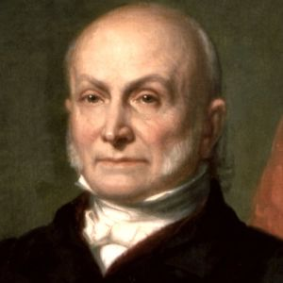

Slide 17
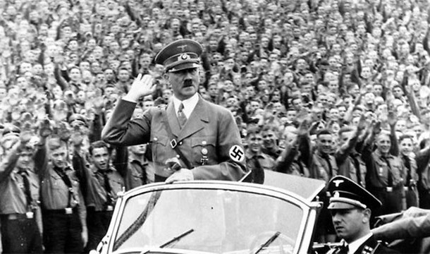

Slide 18
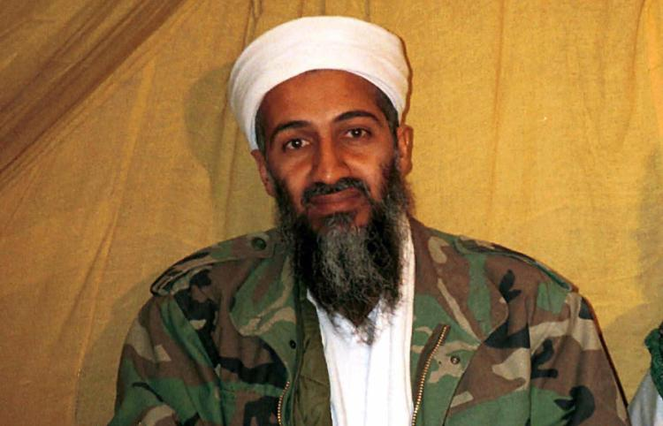

Slide 19
Leadership Considerations
Leadership Positions
Formal (Assigned), Informal (Emergent)
Power
Referent, Expert, Legitimate, Reward, Coercive
Authority
Traditional, Charismatic, Legal
Notes:
•Assigned (Formal) Leaders
–Hold positions to which leadership responsibilities are assigned
•Emergent (Informal) Leaders
–Do not hold formal leadership positions but others perceive them to be the most influential member of the group, often this emerges over time. Common characteristics include: “being verbally involved, being informed, seeking others’ opinions, initiating new ideas, and being firm but not rigid (Fisher, 1974).”
Bases of Power --French and Raven identify five bases of power.
Referent Power –Based on follower’s identification and liking for the leader. A school teacher who is adored by her students has referent power.
Expert Power –Based on followers’ perceptions of the leader’s competence. A tour guide who is knowledgeable about a foreign country.
Legitimate Power –Associated with having status or formal job authority. A judge who administers sentences in the courtroom exhibits legitimate power.
Reward Power –Derived from having the capacity to provide rewards to others. A supervisor who gives rewards to employees who work hard is using reward power.
Coercive Power –Derived from having the capacity to penalize or punish others. A coach who sits players on the bench for being late to practice is using coercive power.
Authority Types
Traditional authority is legitimated by the sanctity of tradition. The ability and right to rule is passed down. It does not change overtime, does not facilitate social change, tends to be irrational and inconsistent, and perpetuates the status quo.
Charismatic authority is found in a leader whose mission and vision inspire others. It is based upon the perceived characteristics of an individual.
Legal-rational authority is empowered by a formalistic belief in the content of the law (legal) or natural law (rationality). Obedience is not given to a set of uniform principles.

Slide 20
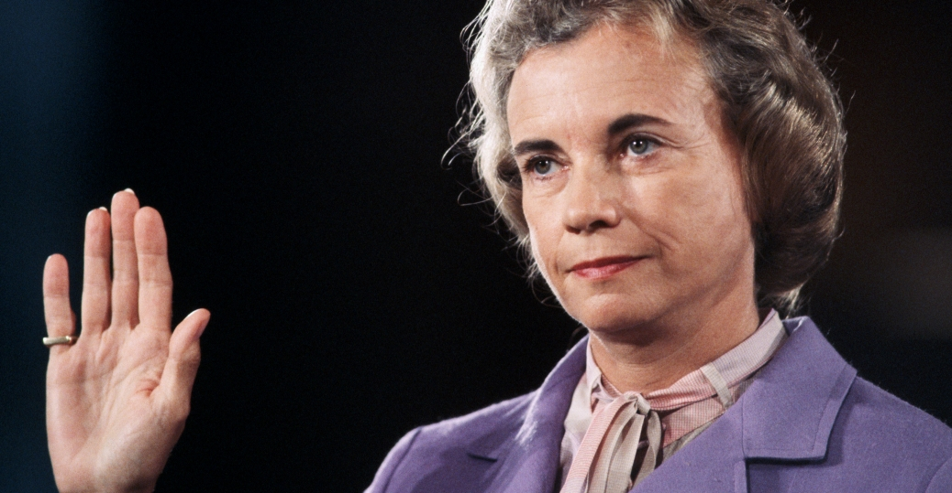

Slide 21
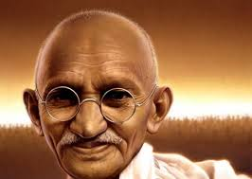

Slide 22
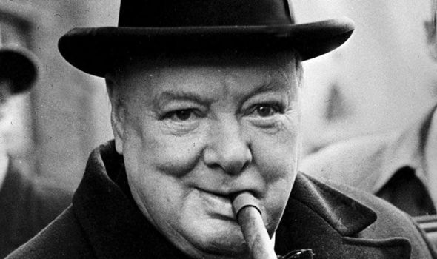

Slide 23
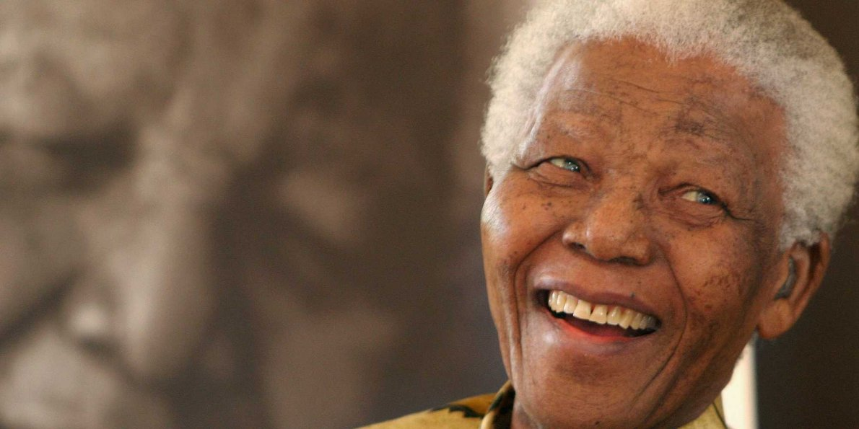

Slide 24
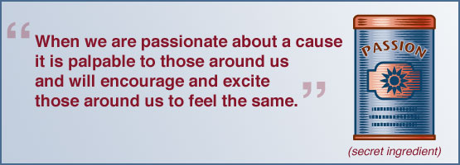
Leadership Identification
Vision
produce/inspire goal directed activities
Communicates positive outlook
Contagiously excited about the future
Notes:
Famous for different reasons with different styles, different traits...but all of them had a vision and....passion
It seems to be one of those qualities that you know when you see it, but is difficult to describe. Many associate leadership with one person leading. Four things stand out in this respect. First, to lead involves influencing others. Second, where there are leaders there are followers. Third, leaders seem to come to the fore when there is a crisis or special problem. In other words, they often become visible when an innovative response is needed. Fourth, leaders are people who have a clear idea of what they want to achieve and why. Thus, leaders are people who are able to think and act creatively in non-routine situations – and who set out to influence the actions, beliefs and feelings of others. In this sense being a ‘leader’ is personal. It flows from an individual’s qualities and actions. However, it is also often linked to some other role such as manager or expert. Here there can be a lot of confusion. Not all managers, for example, are leaders; and not all leaders are managers.

Slide 25
Management Leadership
MANAGEMENT
the process of working with and through others to accomplish organizational goals.
LEADERSHIP
is any time one influences the behavior of another person or group.

Slide 26
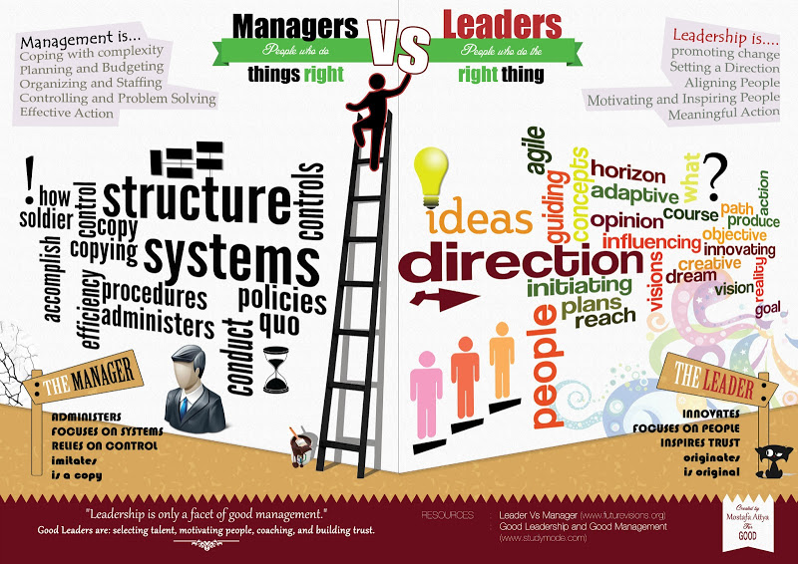
Notes:
MANAGING
(Doing things right)
Administration Maintenance Systems/Structure Short Range How? Compliance Control
MANAGEMENT
• Coping with complexity
• Setting goals
• Planning & budgeting
• Organizing & staffing
• Controlling & problem
solving
LEADING
(Doing the right things) Innovation Development People Long Range What/Why? Commitment Empowerment
LEADERSHIP
• Coping with change
• Setting Direction/vision
• Communicating new
direction
• Aligning people
• Motivating & inspiring

Slide 27
Leadership Identification and popular opinion

Slide 29
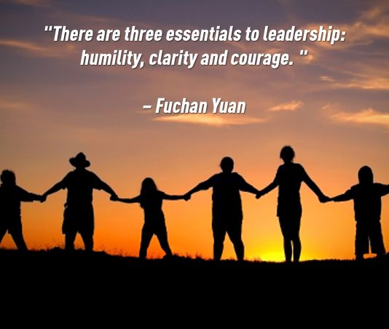

Slide 30
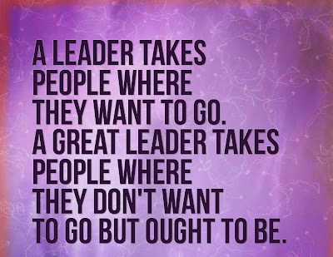
Leadership
Leadership

Slide 31
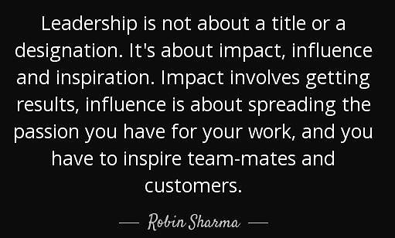

Slide 32
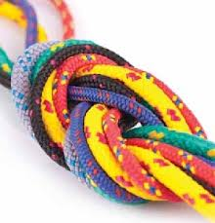
Notes:
Let me see if I can tie this all together, we have a basic understanding of leadership theory and its development....where it is today, we acknowledge that leadership is a process requiring a group and a goal that is sought after, and all leaders have in common a vision or goal that they are striving towards along with the group.
Is this important to us as practitioners both as a group and individuals? What does it have to do with having a professional voice?

Slide 33
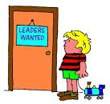
What does Leadership have to do with the RCP
New Members
Service initiatives
Growth and Development
Interdisciplinary Relationships
Professional Organization
Engagement
Notes:
Creates an empowered engaged unit of professionals
We must recognize that within our roles we have the ability, opportunity and obligation to assume leadership of ourselves and stop burdening our managers.

Slide 34
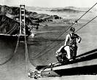
Benefits of Leadership Skills
Provides vision and direction
Brings clarity
Affords confidence
Stretches our thinking
Improves our skills
Expands our view by creating experiences
Raises our self-image
Increases Teamwork

Slide 35
Kouzes and Posners’ Five Leadership Practices
from The Leadership Challenge
Inspires a Shared Vision
envision the future and enlighten others.
2. Challenges the Process
search for opportunities for improvement and experimenting.
3. Enables Others to Act
strengthening their skills and fostering collaboration.
4. Models the Way
setting an example and planning for small wins.
5. Encourages the Heart
recognize contributions and celebrate accomplishments.
Notes:
Jim Kouzes and Barry Posner have been working together for more than thirty years, studying leaders, researching leadership, conducting leadership development seminars, and serving as leaders themselves in various capacities. They are coauthors of the award-winning, best-selling book The Leadership Challeng
INSPIRING A SHARED VISION James Kouzes and Barry Posner, in The Leadership Challenge
Inspires a Shared Vision
• Describes the future we can create, Shares future dreams, Communicates positive outlook, Enlists a common vision, Forecasts the future, Contagiously excited about the future
Challenge the process
• Seeks challenges, Stays up to date, Challenges the status quo, Looks for ways to innovate, Asks "What can we learn?“, Experiments and takes risks
Enables others
• Involves others in planning , Treats others with respect, Allows others to make decisions , Develops cooperative relationships, Gets others to own project
• Models the way
• Clear on leadership philosophy, Breaks projects into steps, Ensures values are adhered to, Practices what is espoused, Sets clear goals and milestones
• Encourages Heart
• Celebrates milestones, Recognizes others' contributions, Gives praise for a job well done, Gives team appreciation/support, Finds ways to celebrates, Tells others about group's work

Slide 36
Inspire a Shared Vision

Slide 37
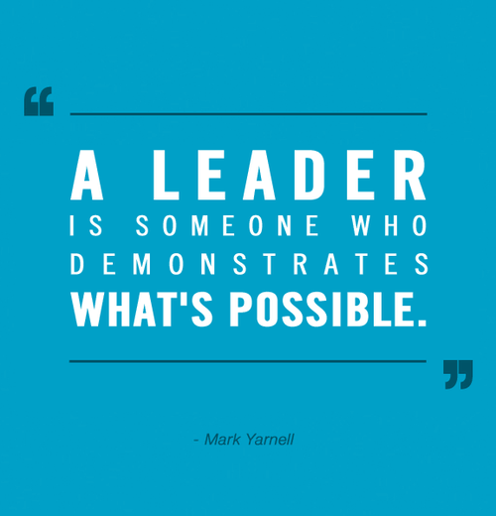
Challenge The Process

Slide 38
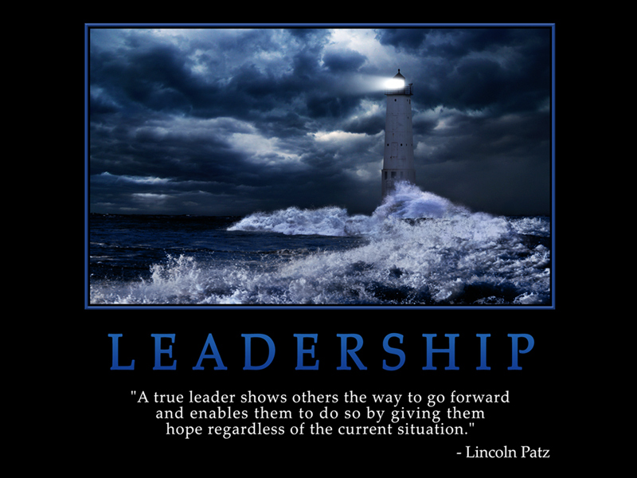
Enable Others to Act

Slide 39
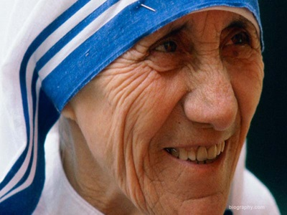
Model The Way

Slide 40
Encourage The Heart

